Slide 1
Pipes Game
Twitch mechanic, puzzle solving co-op game
2 players
Tablets (iOS and Android)
2D or 3D
Multiple levels

Slide 2
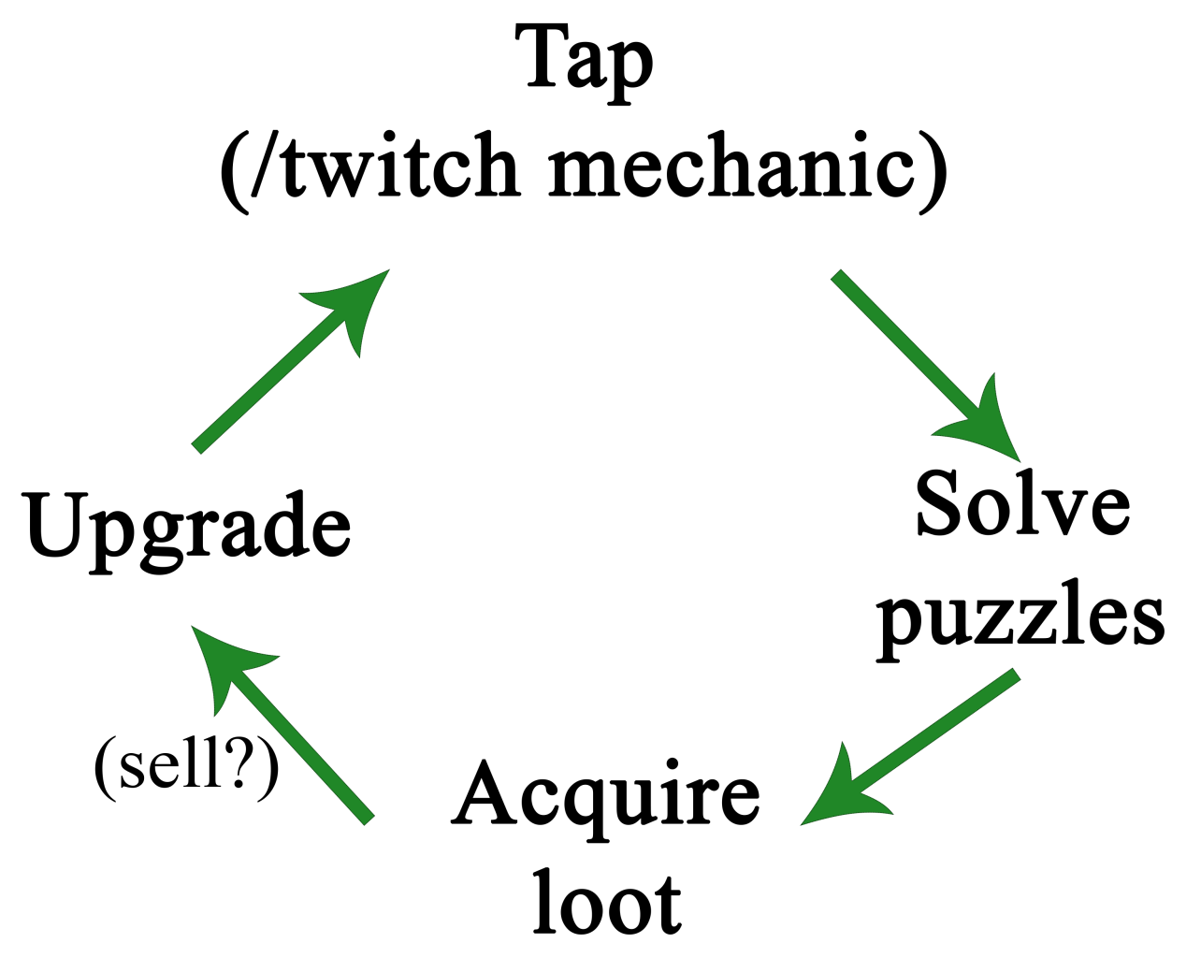
What will the player do, in what order?

Slide 3
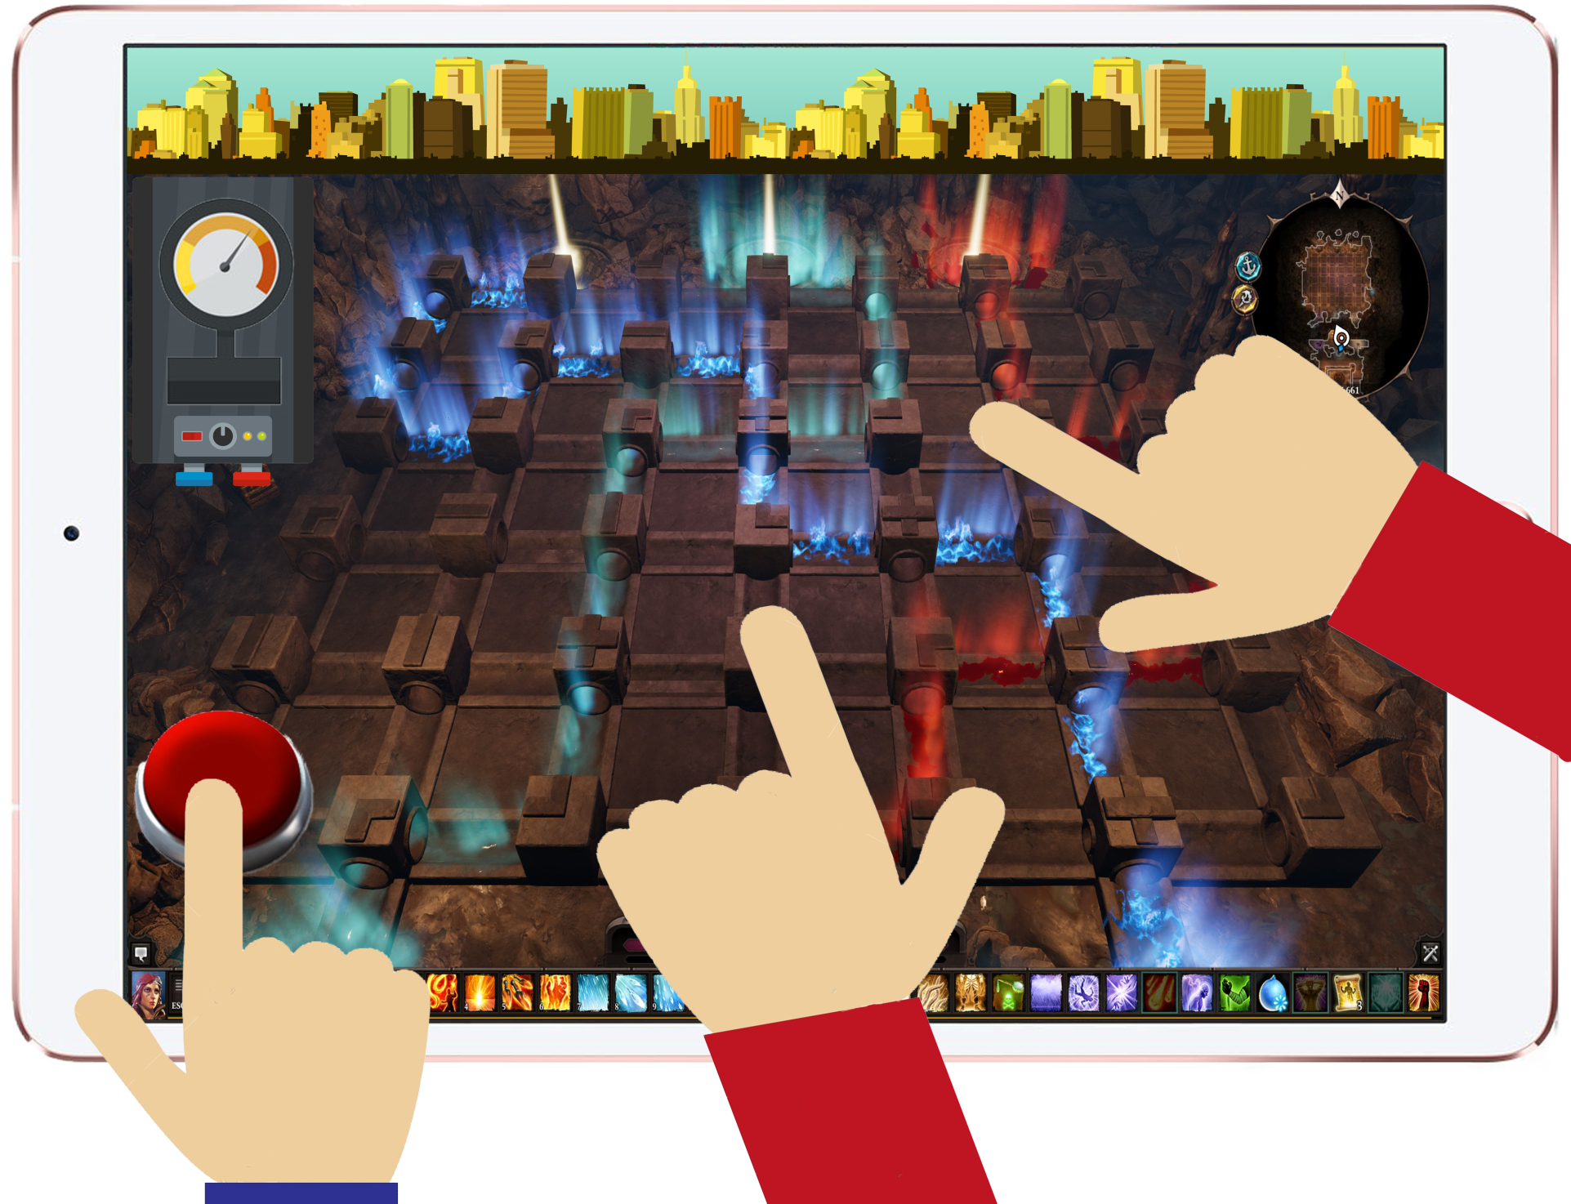
?
?

Slide 4
Target audience
People aged 7-25
Both genders

Slide 5
Why we didn’t choose this idea
Feedback received upon presenting the idea said that the game itself is ‘too generic’
There are too many puzzle games of this type on the market
The idea was bringing nothing new (innovative) to the table
Raised the question
“Why would you have a second player continuously tap to pump the water? Where is the fun in that?”

